Slide 1



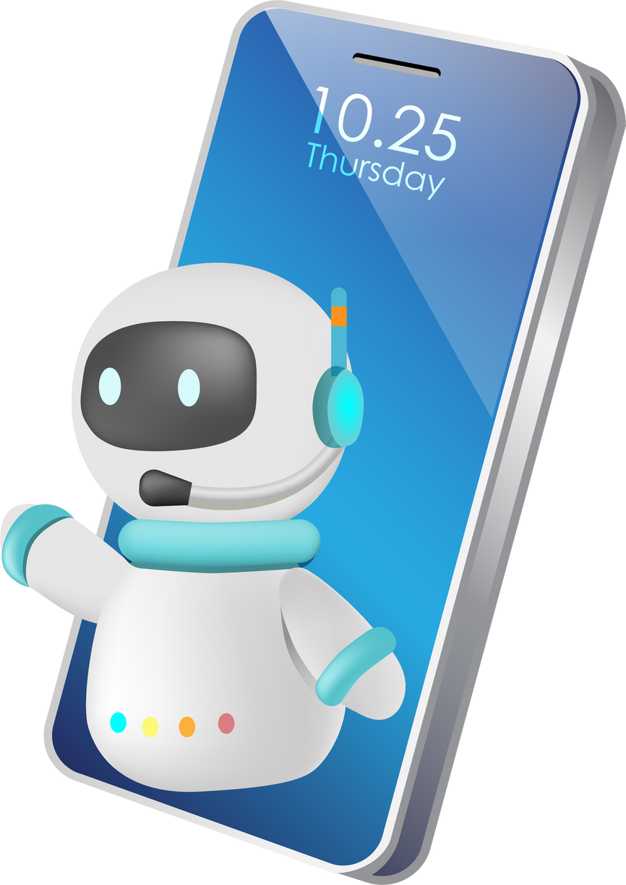
IBM AI-ML Internship Project
Title: Smart-CAPTCHA-Aid
Development of an AI-Based OCR Tool for Reading
CAPTCHA Challenges Aloud to Visually Impaired Users
Presented by: Beginner’s luck
Group Members:
A Kalaiyarasi
Abitha Prasad
Aleena M B
Angel Theres Sanoj
College: Rajagiri School of Engineering & Technology

Slide 2
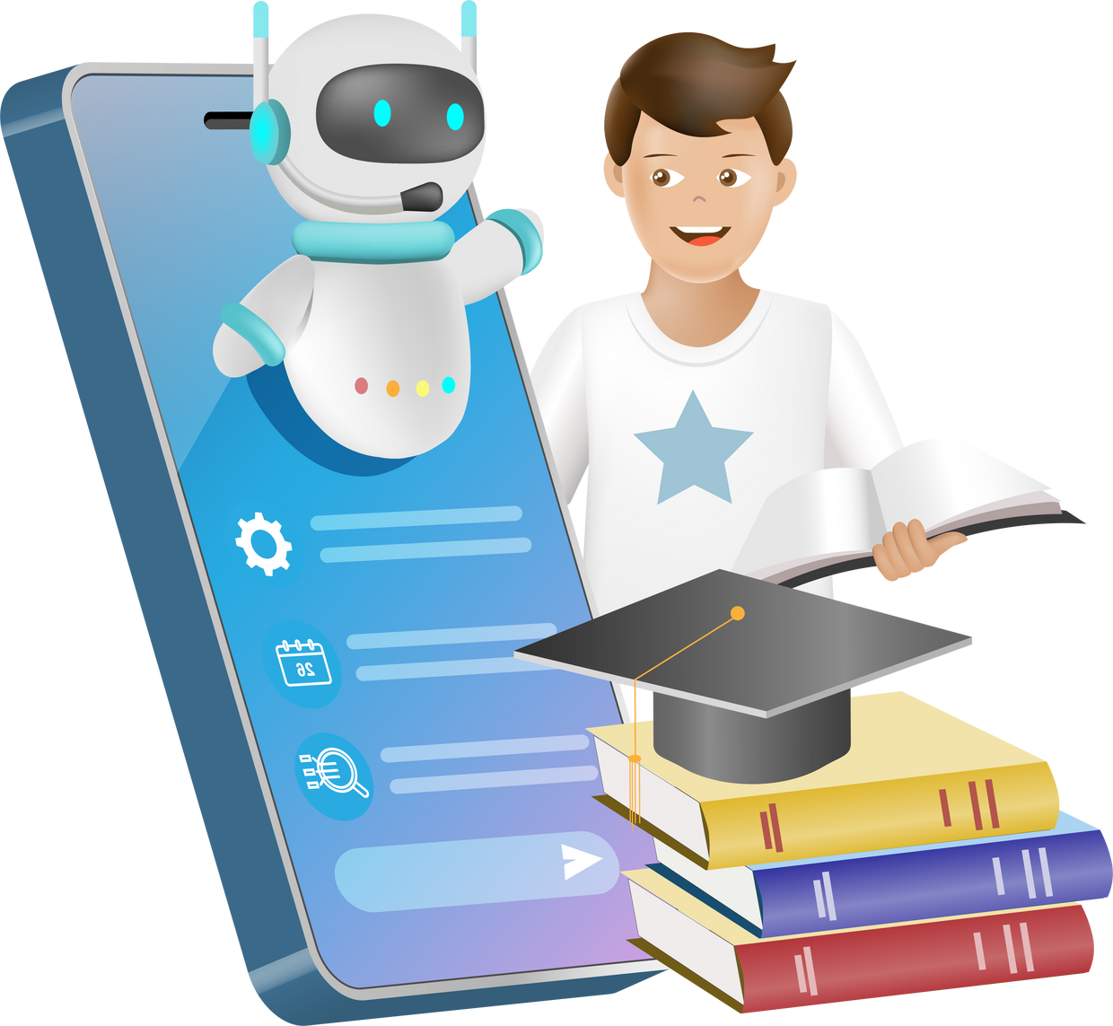
Introduction
Overview:
CAPTCHA is widely used to protect websites from bots.
Text-based CAPTCHAs require users to visually identify and enter distorted text/images.
While effective, these CAPTCHAs present significant accessibility barriers for visually impaired users.
Current Challenges:
Visually impaired users cannot interpret visual CAPTCHAs without external help.
Existing CAPTCHA alternatives (like audio CAPTCHAs) are often unclear, distorted, or unavailable.
Lack of inclusive design limits equal access to digital services.
Potential Solution:
Develop an AI-powered OCR tool to extract and convert CAPTCHA text into speech.

Slide 3
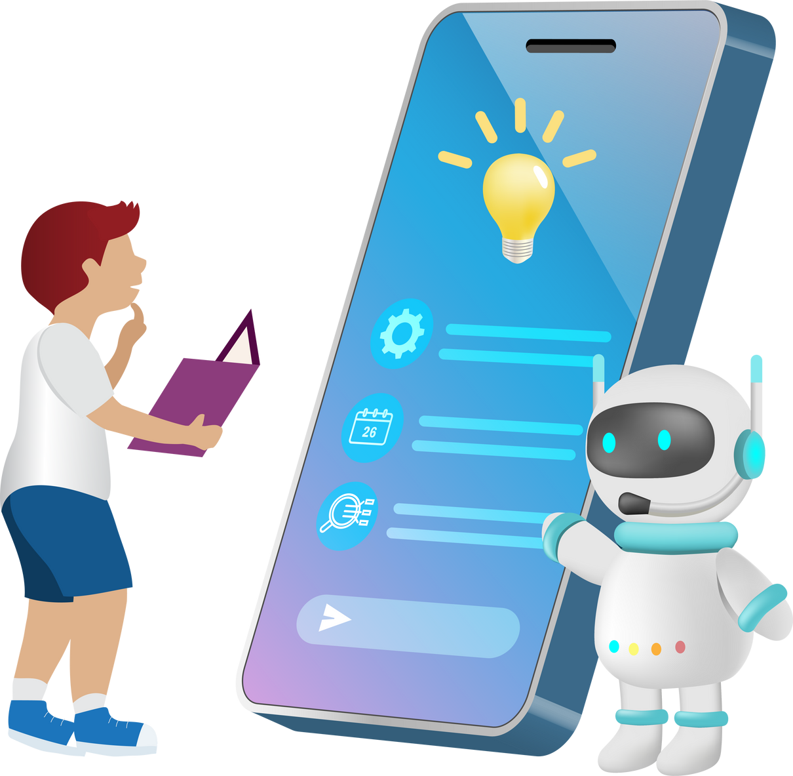
Problem Statement
Objective:
To develop an AI-powered solution that makes text-based CAPTCHA challenges accessible for visually impaired users by converting CAPTCHA images into spoken output using OCR and text-to-speech technologies.
Specific Goals:
Use Optical Character Recognition (OCR) to accurately extract text from CAPTCHA images.
Implement the solution on Google Colab for easy prototyping and testing.
Convert the extracted text into speech output using text-to-speech libraries.
Ensure minimal user interaction to promote independent usage by visually impaired users.
Validate the model on sample CAPTCHA datasets for reliability and usability.

Slide 4

Sustainable Development Goal (SDG)
Goal Chosen:
SDG 10 – Reduced Inequalities
Problem Statement:
Visually impaired users face significant barriers in accessing websites protected by visual text-based CAPTCHAs. Existing alternatives like audio CAPTCHAs are often ineffective, distorted, or unavailable.
Rationale:
CAPTCHA systems are essential for cybersecurity but exclude individuals with visual impairments.
Equal digital access is a right; barriers to CAPTCHA access limit independence.
Our OCR-based CAPTCHA reader enables inclusive web access, aligning directly with SDG 10 by promoting digital equality and accessible technology for all.

Slide 5
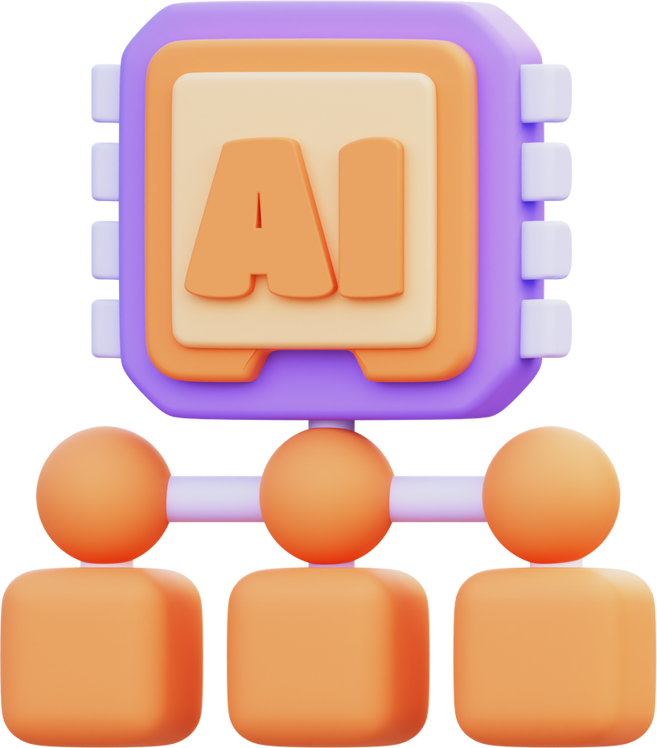
Data Collection and Preprocessing
Source:
CAPTCHA image dataset from archive.zip with a subfolder samples.
Preprocessing Steps:
Unzipped and loaded images in Google Colab.
Resized images to uniform dimensions (e.g., 50×200).
Converted to grayscale.
Normalized pixel values.
Extracted labels from filenames.

Slide 6
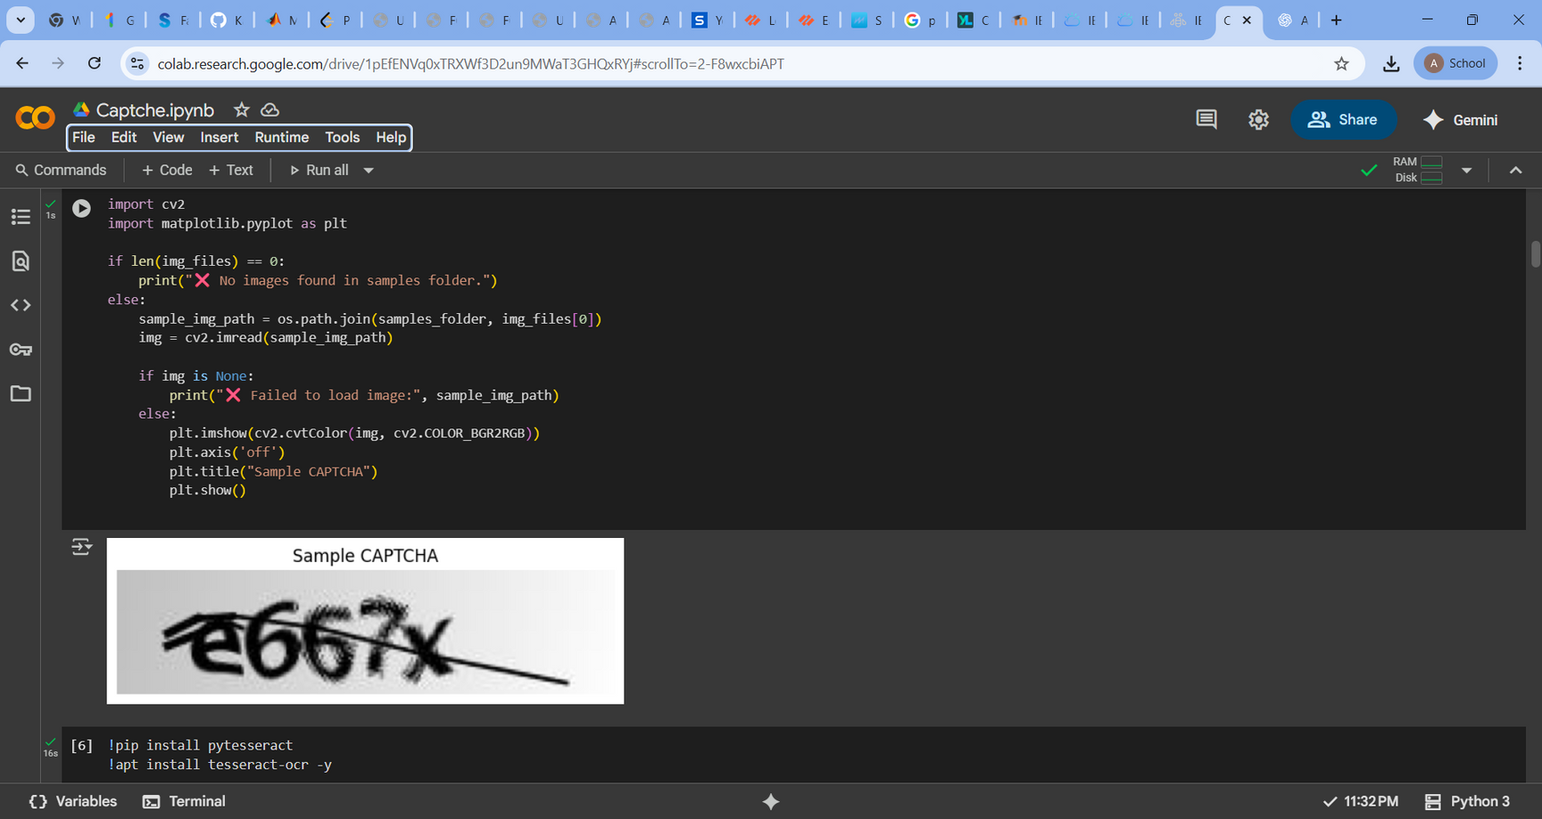
Data Collection and Preprocessing

Slide 7

Model Development
Model type:
CNN-based multi-output classifier.
Framework:
TensorFlow/Keras (in Google Colab).
Architecture:
2 convolution layers → MaxPooling
Flatten + 5 Dense outputs (one per CAPTCHA character)

Slide 8
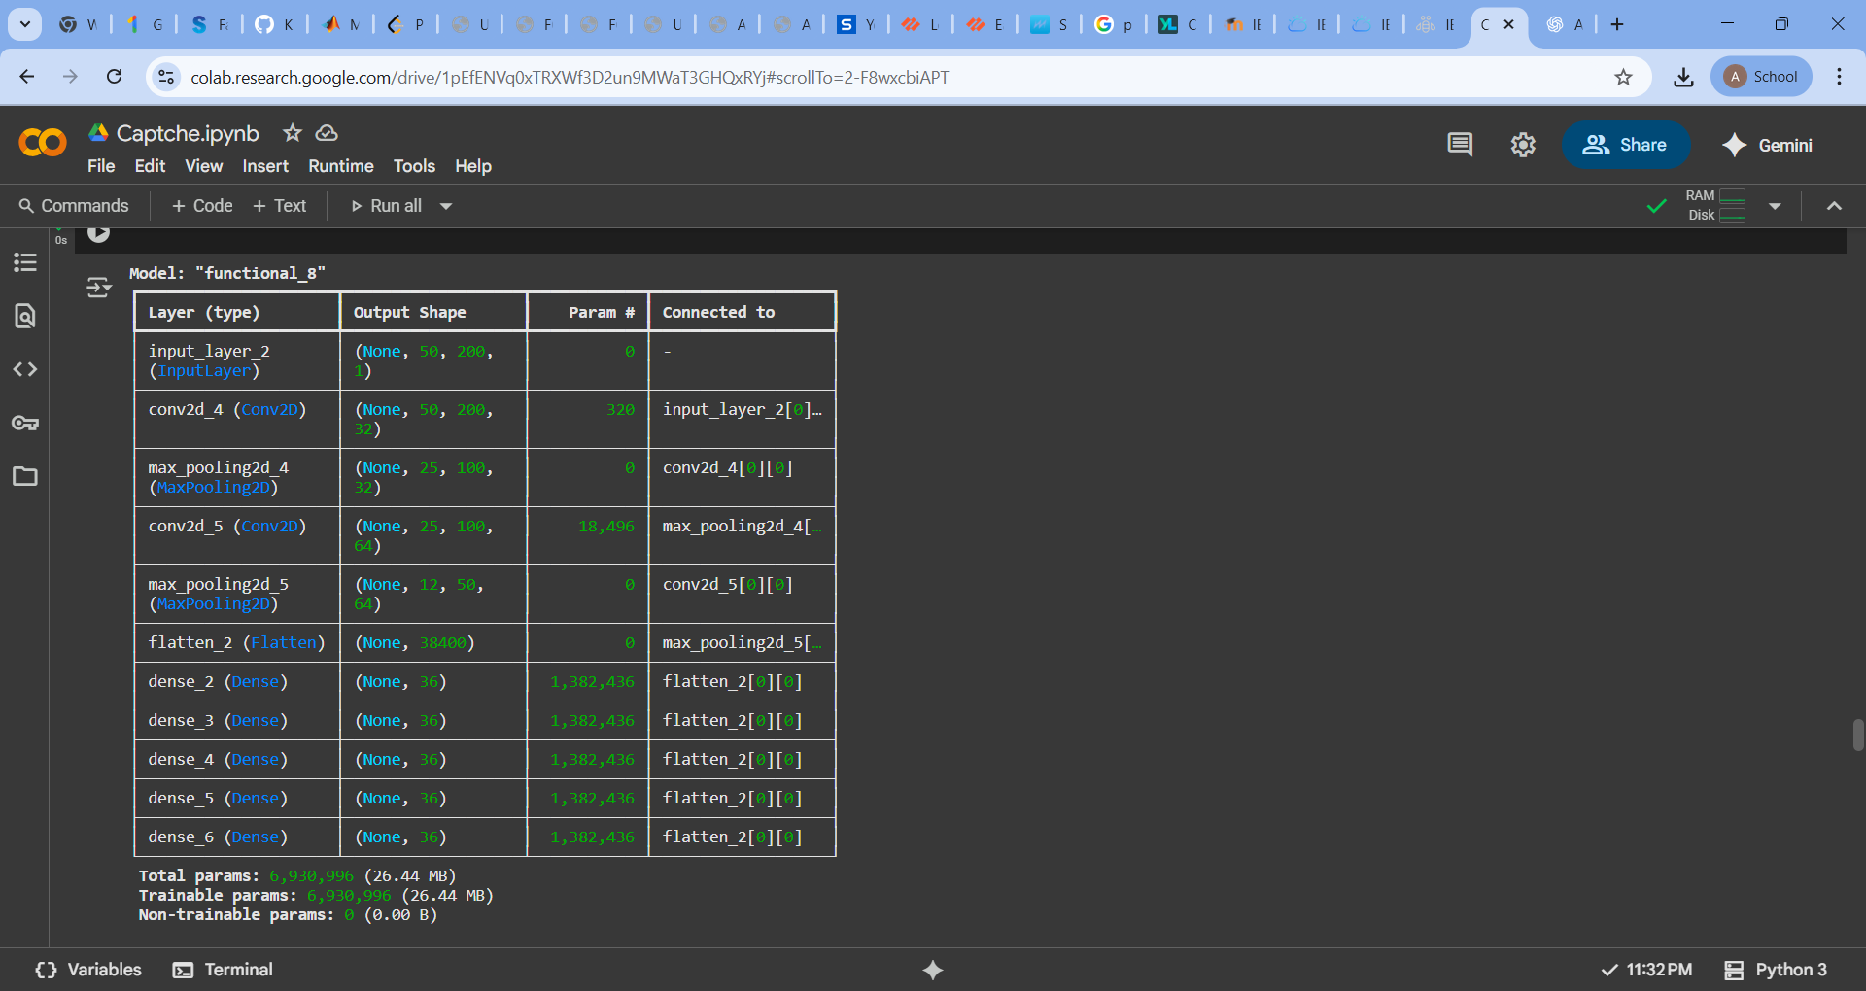
Model Development

Slide 9
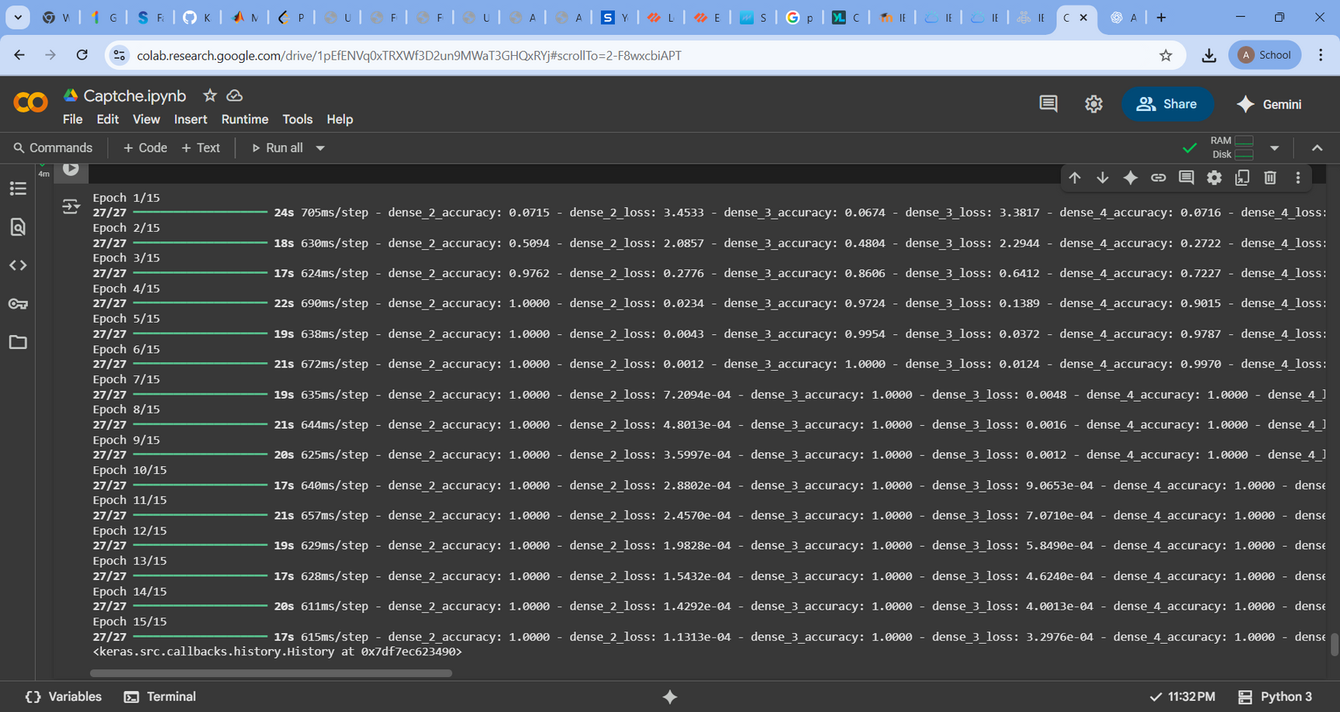
Model Training and Evaluation
Trained for 15 epochs with early signs of overfitting after epoch 5.
Accuracy (dense_2 to dense_6): ranges from ~95% to 66% on validation set.

Slide 10
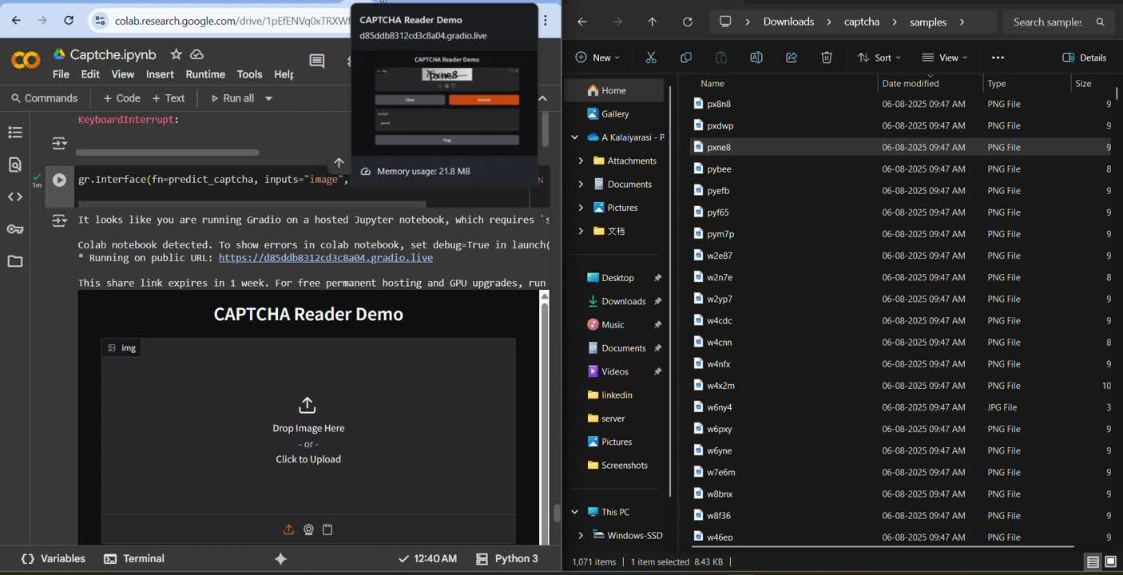
DEMO

Slide 11
Tools and Resources
Platform: Google Colab,Gradio
Languages/Libraries: Python, TensorFlow/Keras, NumPy, Matplotlib, OpenCV, sklearn
Impact and Effectiveness
Makes CAPTCHA readable for visually impaired users.
Promotes digital inclusivity and autonomy.
Aligns directly with SDG Goal 10: Reduced Inequalities.
Potential for real-world deployment in screen readers or browser extensions.

Slide 12
Why It Will Work?
Simple, lightweight, and easy to implement.
Uses publicly available datasets.
Built using free tools (Google Colab), so it’s accessible to all.
Can be integrated into existing accessibility tools.
Conclusion and Future Work
Summary: Built a working CAPTCHA reader that converts visual CAPTCHA to text
Future Work:
Handle complex/distorted CAPTCHAs.
Expand to audio CAPTCHAs.
Deploy as browser plugin or assistive mobile app.
Improve generalization across unseen CAPTCHA styles.

Slide 13

LINK
https://github.com/Kalaiiiiii/Smart-CAPTCHA-Aid

Slide 14
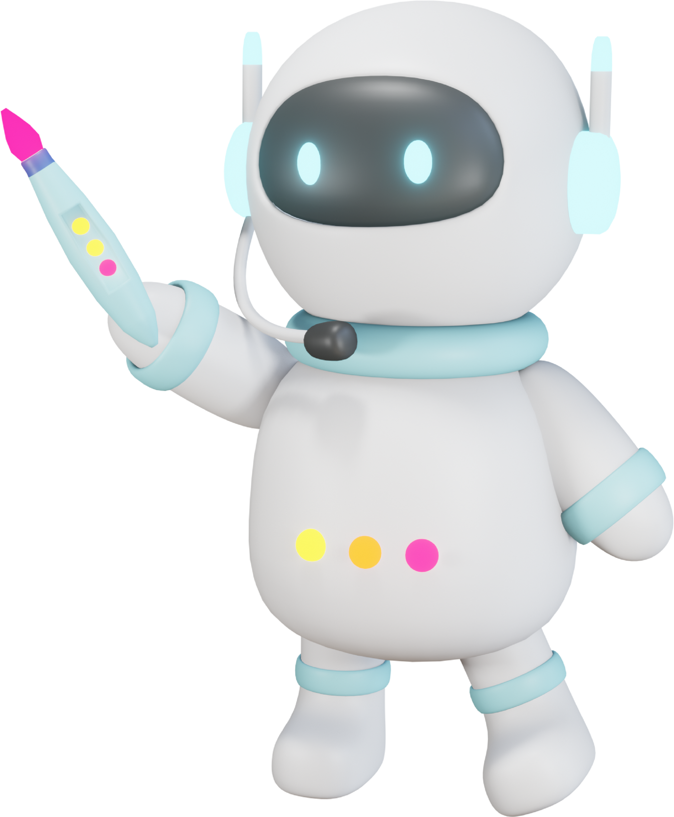
Thank You!!
Let's work together to harness the power of AI in education while upholding ethical principles.
-Beginner’s luck

